Slide 1
@LeicInnovation #CopernicusHackathon #FoodSecurity

Slide 2
@LeicInnovation Economic Growth enabled by the Copernicus Programme
Carmine Maffei, Innovation Fellow
Svetlana Zolotikova, Copernicus Relay

Slide 3
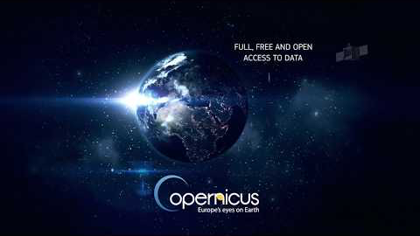

Slide 4
https://youtu.be/KjgevEUge9U

Slide 5
COPERNICUS IN BRIEF
Copernicus, a flagship programme of the European Union:
Monitors the Earth, its environment and ecosystems
Prepares for crises, security risks and natural or man-made disasters
Contributes to the EU’s role as a global player
Adopts a full, free and open data policy
Is a tool for economic development and a driver for the digital economy

Slide 6
COPERNICUS USER UPTAKE STRATEGY
Promote the uptake of Copernicus data and services
1
2
3
Ensure
Access
Boost
Innovation
Increase
Awareness
And Use
Upstream & Midstream
Downstream
Users
Notes:
Objectives of the user and market uptake :
Ensure easy access to space data
Boost innovation in the downstream sector
Maximise the use of space applications by users from both
Public sector
Private sector

Slide 7
COPERNICUS HISTORY
Baveno Manifesto
GMES – Flagship of EU Space Policy
EC-ESA Agreement on GMES
Copernicus Regulation and Data Policy
1998
2005
2008
GMES → Copernicus
2013
2001
2006
2011
2014
Gothenburg EU Summit
EC - GMES Bureau
Start of GMES GIO
Start of
Full service operations
GIO = GMES Initial Operation
Notes:
GIO- GMES Initial Operations

Slide 8
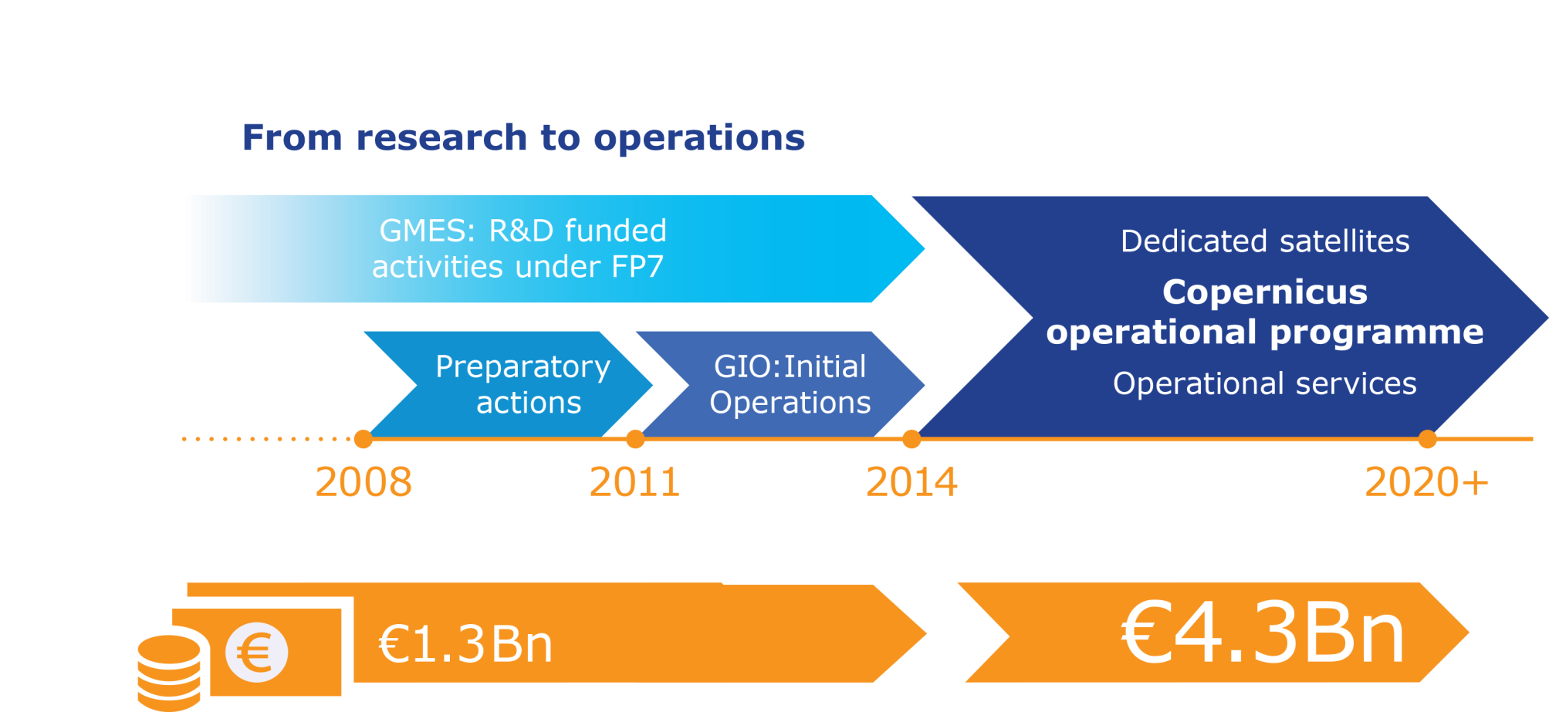
COPERNICUS FUNDING
Notes:
Current MFF period (2014-2020): full operationalisation for the Copernicus Infrastructure and Services
Adequate budgetary provisions to:
Reach the key milestones by 2017
Ensure the smooth running of the programme on a 24/7/365 basis
Lay the necessary groundwork for the future

Slide 9
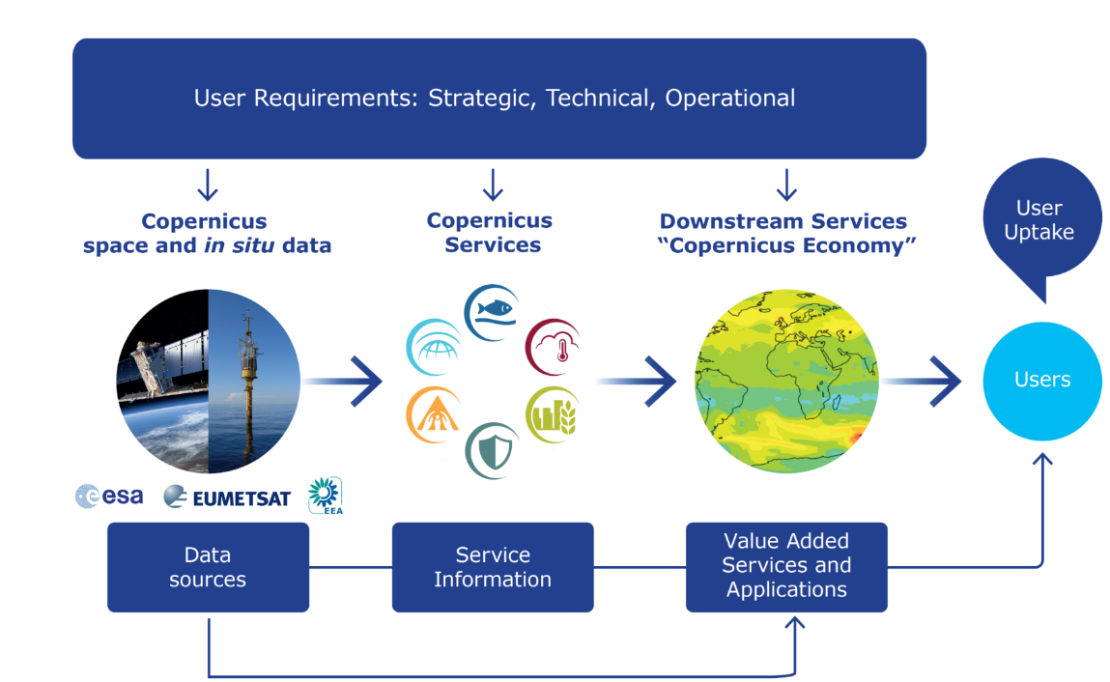
COPERNICUS IS DRIVEN BY THE USERS

Slide 10
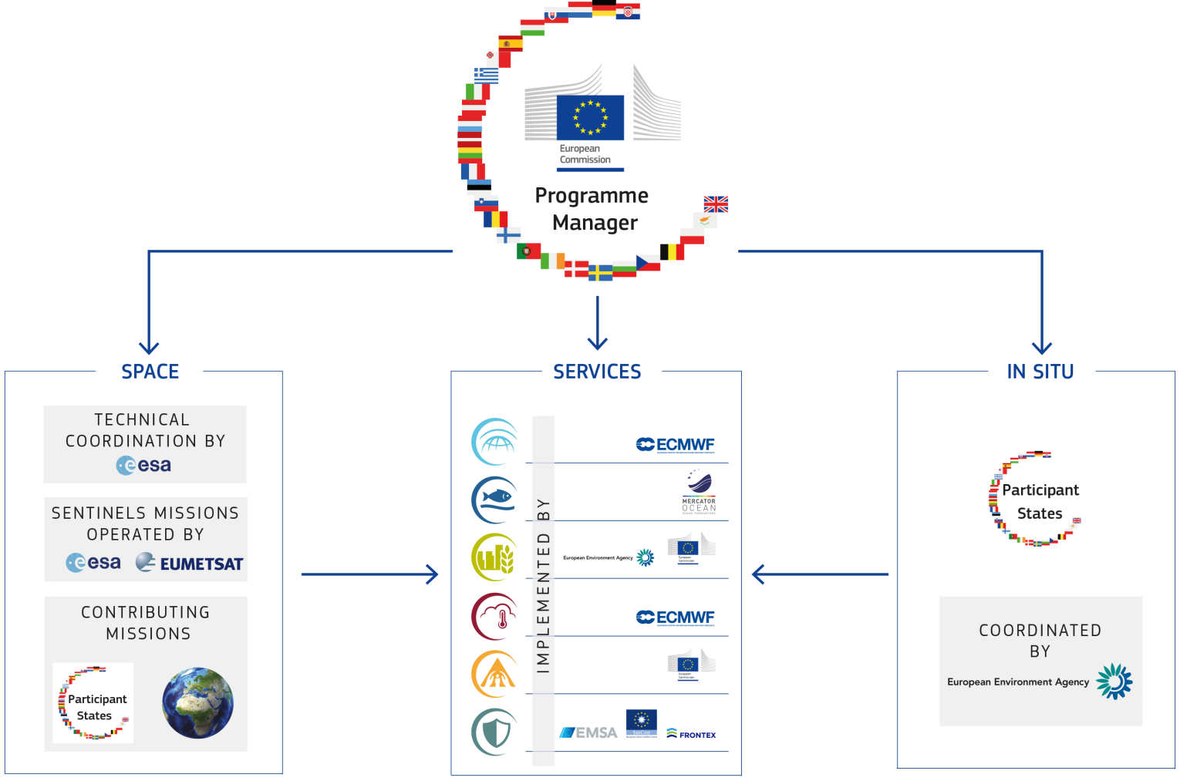
COPERNICUS GOVERNANCE

Slide 11
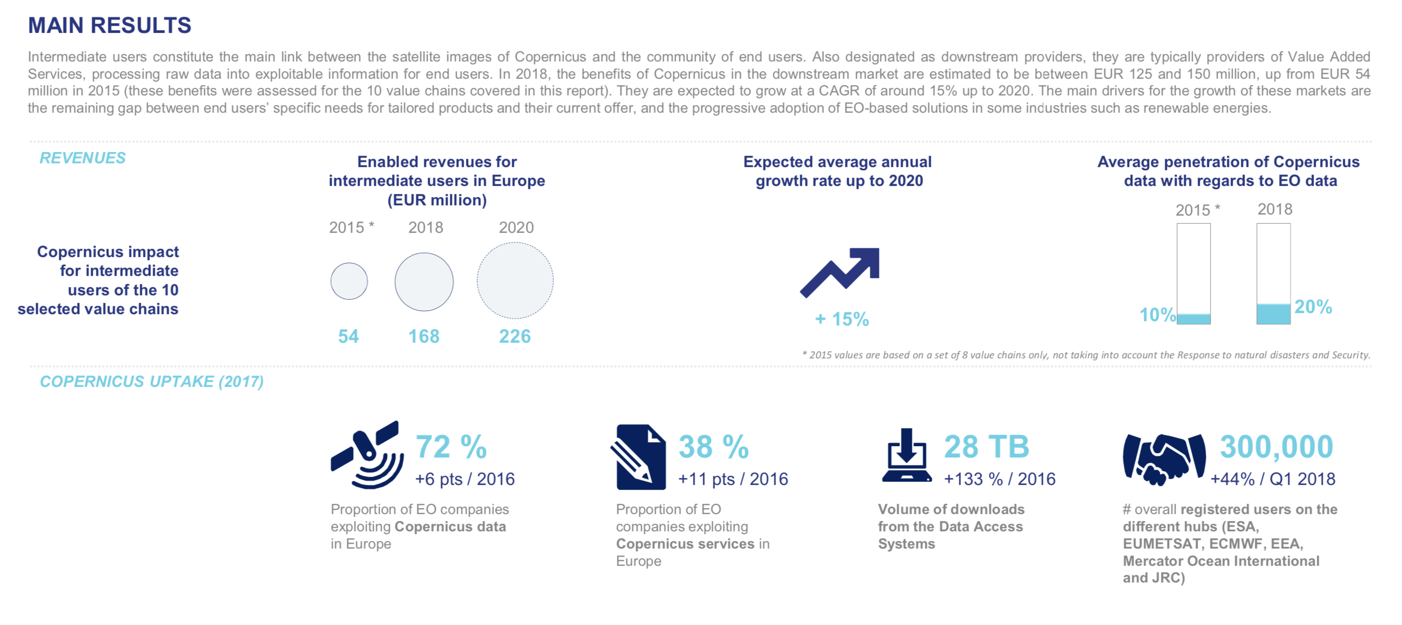
Copernicus Intermediate users’ benefits (1)
© European Union

Slide 12
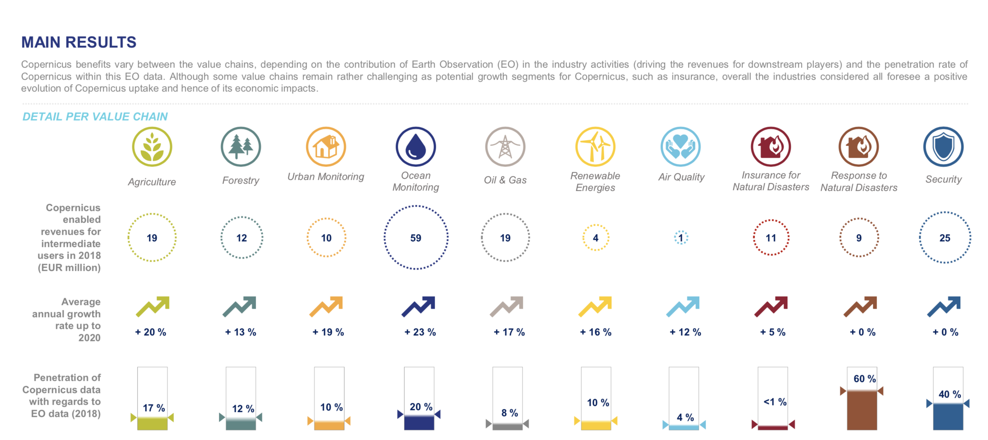
Copernicus Intermediate users’ benefits (2)
© European Union

Slide 13
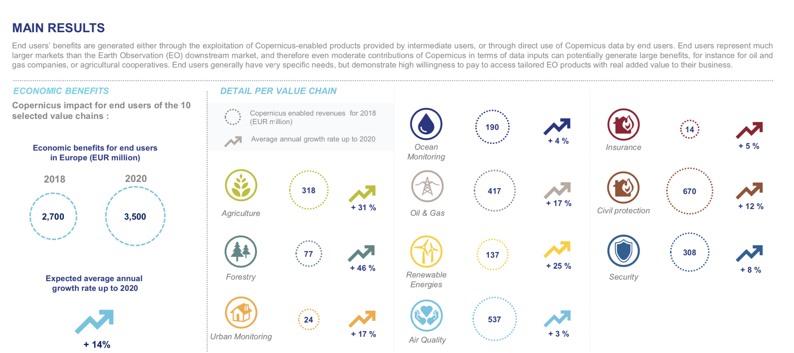
Copernicus End users’ benefits
© European Union

Slide 14
Pivotal role of the University of Leicester
Contribution to the design of satellites and sensors
Leadership in the development of land monitoring services

Slide 15






What it means for Midlands and UK companies
Hosting a Copernicus Relay
Hosting a Copernicus Academy
Part of the CoRDineT network

Slide 16
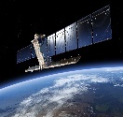
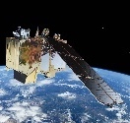
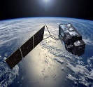
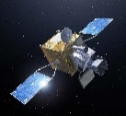
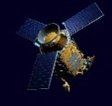
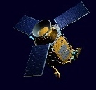
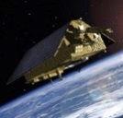
THE SENTINELS
FULL, FREE AND OPEN
Sentinel Mission and Status
Key Features
SENTINEL-1:
9-40m resolution, 6 days revisit at equator
S1-A and -B in orbit
Polar-orbiting, all-weather, day-and-night radar imaging
SENTINEL-2:
10-60m resolution, 5 days revisit time
S2-A and -B in orbit
Polar-orbiting, multispectral optical, high-res imaging
SENTINEL-3:
300-1200m resolution, <2 days revisit
S3-A in orbit
S3-B Spring 2018
Optical and altimeter mission monitoring sea and land parameters
SENTINEL-4:
8km resolution, 60 min revisit time
1st Launch 2020
Payload for atmosphere chemistry monitoring on MTG-S
SENTINEL-5p:
7-68km resolution, 1 day revisit
S-5p launched 13/10/2017
Mission to reduce data gaps between Envisat, and S-5
SENTINEL-5:
7.5-50km resolution, 1 day revisit
1st Launch in 2021
Payload for atmosphere chemistry monitoring on MetOp 2ndGen
SENTINEL-6:
10 days revisit time
1st Launch in 2020
Radar altimeter to measure sea-surface height globally

Slide 17
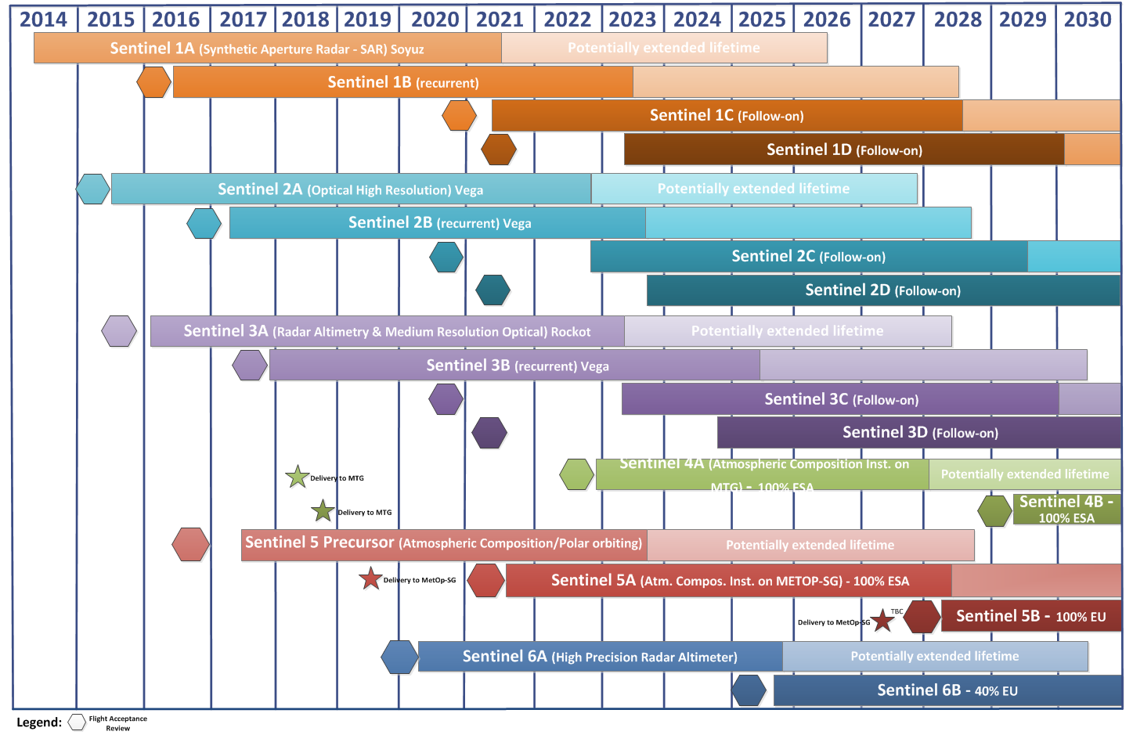
SENTINEL FAMILY DEPLOYMENT SCHEDULE

Slide 18
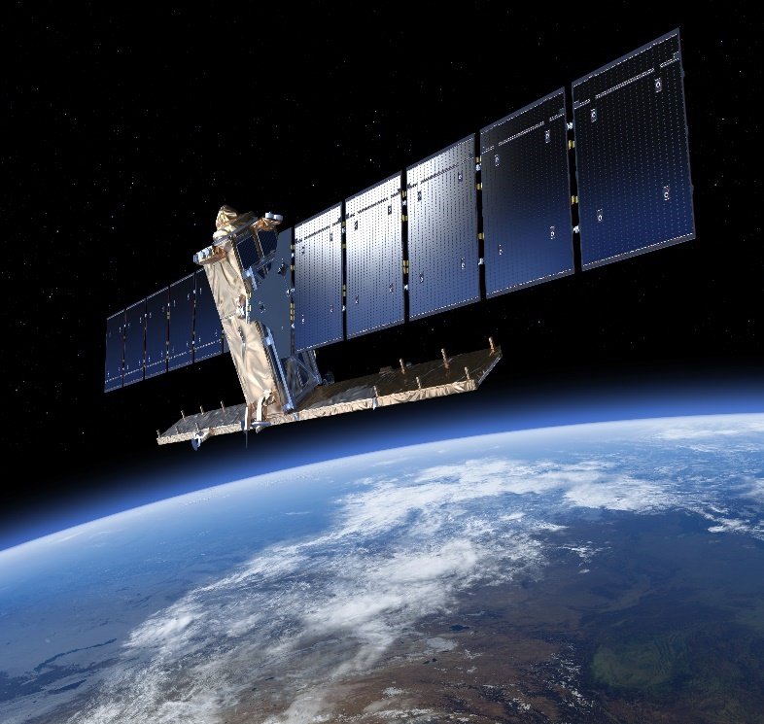





SENTINEL-1
FULL, FREE AND OPEN
Key Features:
SAR sensor - All-weather, day-and-night
9-40m resolution, 6 days revisit time at equator
2 launched on 3/4/2014 and 25/4/2016, 2 ordered
Contributes to:
Copernicus Land Monitoring Service
Copernicus Marine Environment Service
Copernicus Emergency Management Service
Copernicus Climate Change Service
Copernicus Security Service

Slide 19
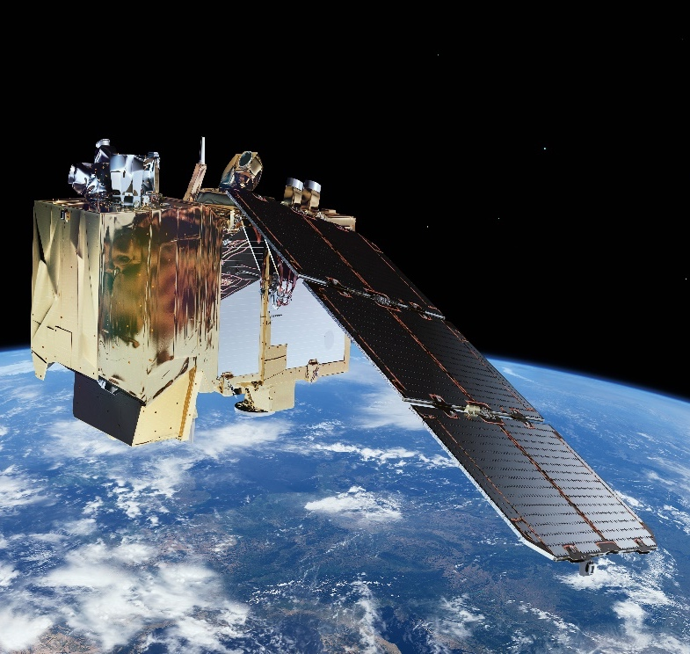
SENTINEL-2
FULL, FREE AND OPEN
Key Features:
Multispectral optical sensor
10-60m resolution, 5 days revisit time
First unit launched on 22/6/2015
Second unit launched on 7/03/2017
2 more units are ordered
Contributes to:
Copernicus Land Monitoring Service
Copernicus Emergency Management Service
Copernicus Climate Change Service
Copernicus Security Service

Slide 20

SENTINEL-3
FULL, FREE AND OPEN
Key Features:
Medium resolution imaging and altimetry
300-1200m resolution, <2 days revisit time
Monitors Sea and Land Surface Parameters
First unit launched on 16/2/2016
Second unit launched on 25/4/2018
2 more units ordered
Contributes to:
Copernicus Land Monitoring Service
Copernicus Marine Environment Service
Copernicus Climate Change Service

Slide 21


SENTINEL-4
FULL, FREE AND OPEN
Key Features:
Onboard MTG-S
Atmospheric Chemistry Mission
8km resolution, 60 min revisit time
To be launched in 2022
Contributes to:
Copernicus Atmosphere Service
Copernicus Climate Change Service
Notes:
Meteosat Third Generation

Slide 22
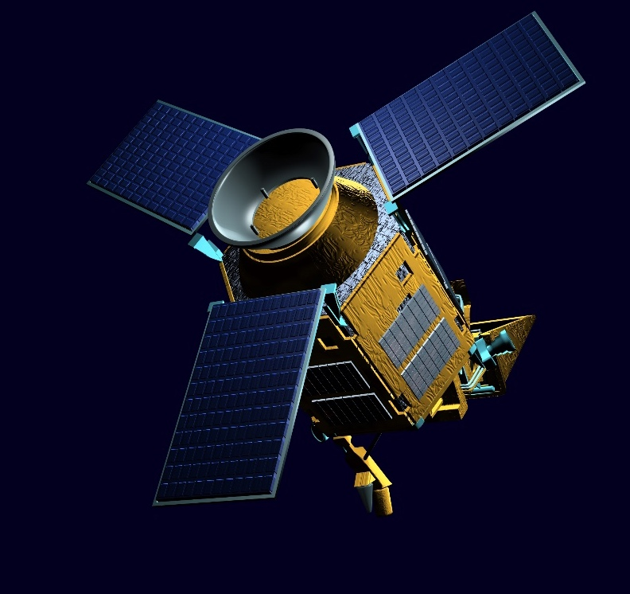
SENTINEL-5p
FULL, FREE AND OPEN
Key Features:
Precursor of Sentinel-5
Atmospheric Chemistry Mission
7-68km resolution, 1 day revisit time
Launched on 13 October 2017
Contributes to:
Sentinel-5 image
Copernicus Atmosphere Service
Copernicus Climate Change Service

Slide 23
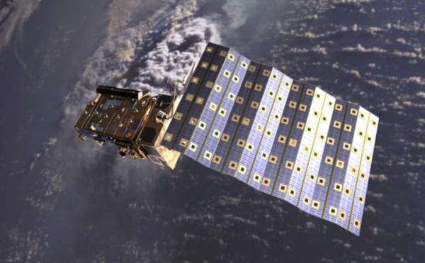
SENTINEL-5
FULL, FREE AND OPEN
Key Features:
Onboard MetOp 2nd Gen
Atmospheric Chemistry Mission
7-50km resolution, 1 day revisit time
To be launched in 2021
Contributes to:
Copernicus Atmosphere Service
Copernicus Climate Change Service

Slide 24
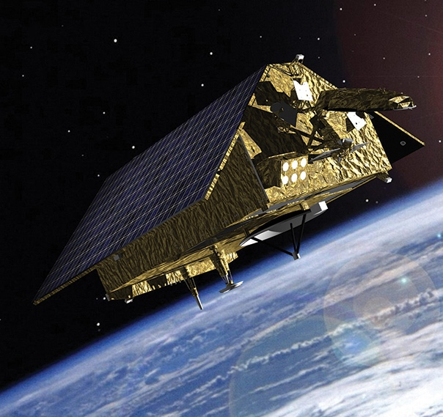
SENTINEL-6
FULL, FREE AND OPEN
Key Features:
Radar Altimeter
Measures sea-surface height
10 days revisit time
To be launched in 2020
Contributes to:
Copernicus Marine Environment Service
Copernicus Atmosphere Service
Copernicus Climate Change Service

Slide 25
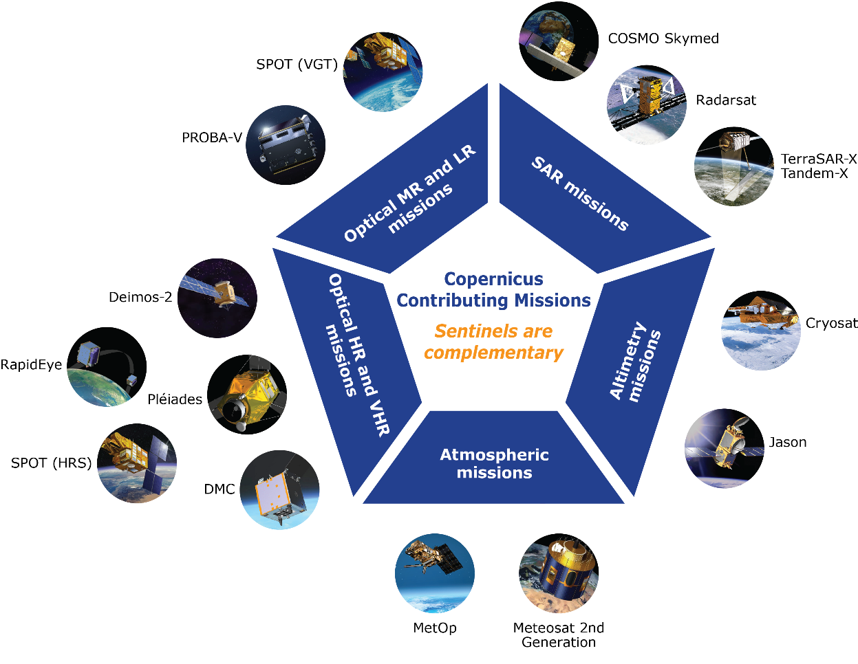
THE CONTRIBUTING MISSIONS
Subject to Data Owner’s Data Policy

Slide 26
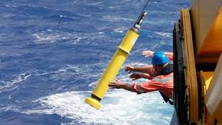
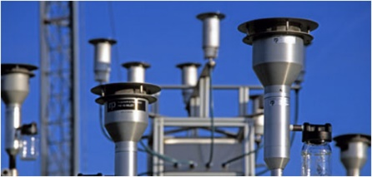
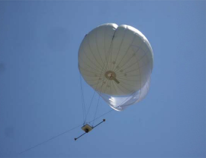
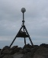
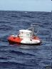
IN-SITU: OVERVIEW
In situ data = observation data from ground-, sea- or air-borne sensors, reference and ancillary data licensed for use in Copernicus
Use of In situ data:
Validate & calibrate Copernicus products
Reliable information services
Implementation in two tiers:
Tailored in situ data for each Copernicus service level
Cross-cutting coordination across services by the EEA
Notes:
In situ data used to produce, validate, calibrate Copernicus products, and to establish reliable information services required by end users
Copernicus in situ component implemented in two tiers:
At each Copernicus service level: tailored in situ data
At Programme level: cross-cutting in situ coordination across services, managed by the European Environment Agency

Slide 27
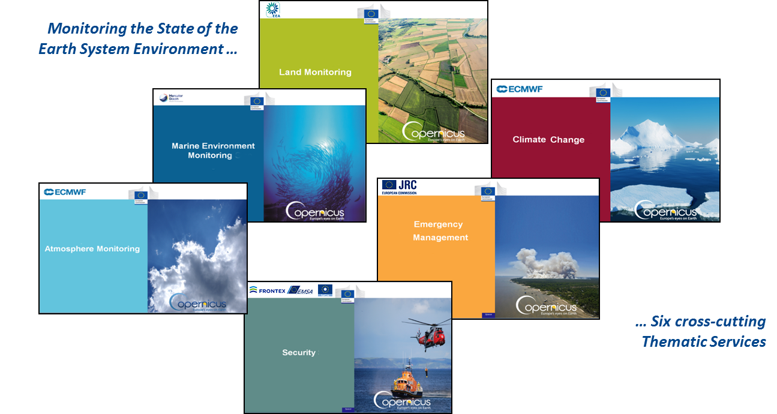






COPERNICUS SERVICES
COPERNICUS SERVICES

Slide 28


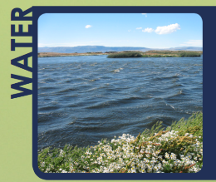
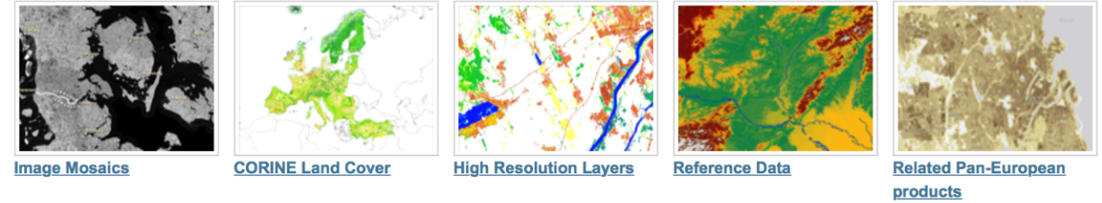
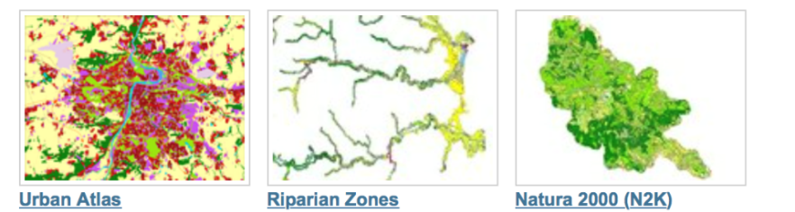
Benefit areas and products examples
Ecosystems
Biodiversity
Agriculture
Forestry
Energy
Natural Resources
Water
Urban planning
Global
Pan-European
EU Land Cover
Specific land cover info
Hydrographic and elevation reference maps
% of built-up area
Local
Notes:
The Land Service is divided into three main components:
Global Land Service (Providing bio-geophysical products of global land surface): is a component of the Copernicus Land service that provides a series of bio-geophysical products on the status and evolution of land surface at global scale at mid and low spatial resolution. Production and delivery of the parameters take place in a timely manner and are complemented by the constitution of long term time series. The products are used to monitor the vegetation, the water cycle and the energy budget.
Pan-European:
The pan-European component provides information about the land cover and land use (LC/LU), land cover and land use changes and land cover characteristics. The latter includes information about imperviousness, forests, natural grasslands, wetlands, and permanent water bodies.
Local:
The local component focuses on different hotspots, i.e. areas that are prone to specific environmental challenges and problems. This includes detailed LC/LU information for the larger EU cities (Urban Atlas), riparian zones along European river networks and NATURA 2000 sites. It will also include maps of coastal area
Note:
The CORINE Land Cover (CLC) inventory was initiated in 1985 (reference year 1990). Updates have been produced in 2000, 2006, and 2012. It consists of an inventory of land cover in 44 classes.

Slide 29
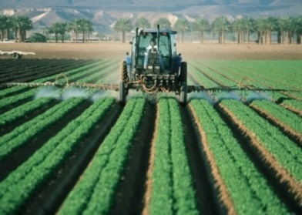
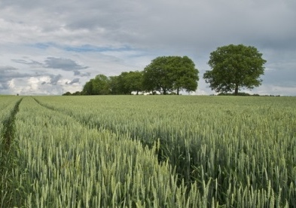
Agriculture sector: Examples of benefits
Applications based on Free Sentinels 1 and 2 Data and the Land Service Products
Precision farming applications such as yield mapping, input management, farm management recording, etc.
Seasonal mappings of cultivated areas
Field scale and crop dynamics mapping
Irrigation management and drought monitoring
Food security monitoring
Agriculture development in Africa
More efficient use of agricultural inputs
€
€
€78M
€
€
€
€
€
Better quality food production
More efficient and appropriate use of fertilizers
€
Expected Copernicus enabled revenues
Sources: PwC-Strategy& analysis & European Commission

Slide 30
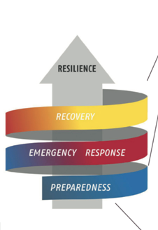
Benefit areas and products examples
Disaster Emergency Situations
Risk & Recovery Mapping:
Reference Maps
Pre-disaster Situation Maps
Post-disaster Situation Maps
Rapid Mapping:
Reference Maps
Delineation Maps
Grading Maps
Humanitarian Crises
Early Warning:
Floods: EFAS
Forest Fires: EFFIS
EFAS = European Flood Awareness System;
EFFIS=European Forest Fire Information System
Notes:
The Copernicus Emergency Management Service (EMS) has three main components, Early Warning andRapid Mapping, /risk and recovery mapping, as well as a dedicated component for the validation of the mapping products.

Slide 31
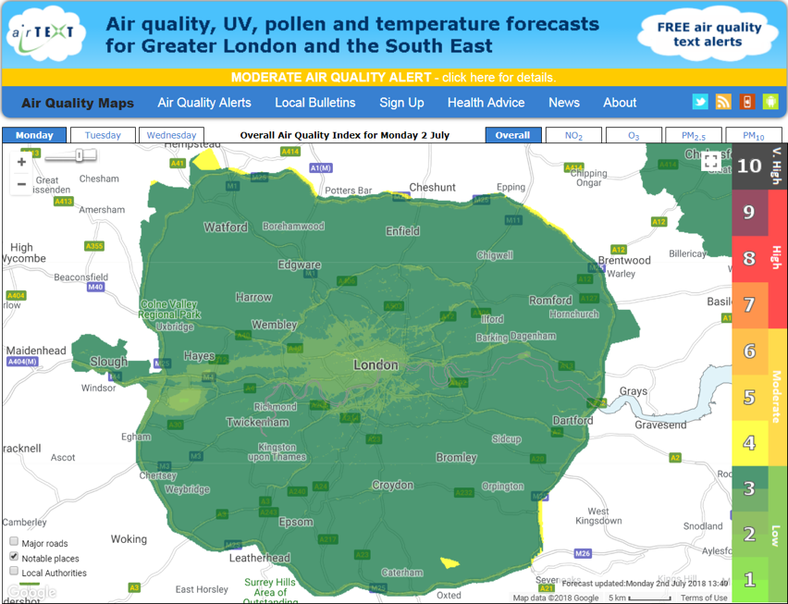
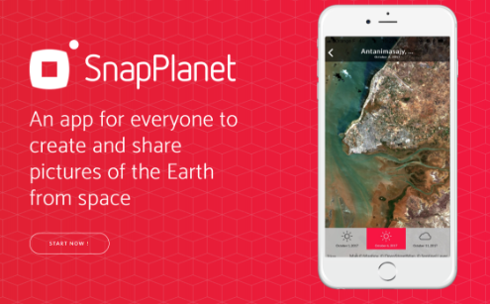
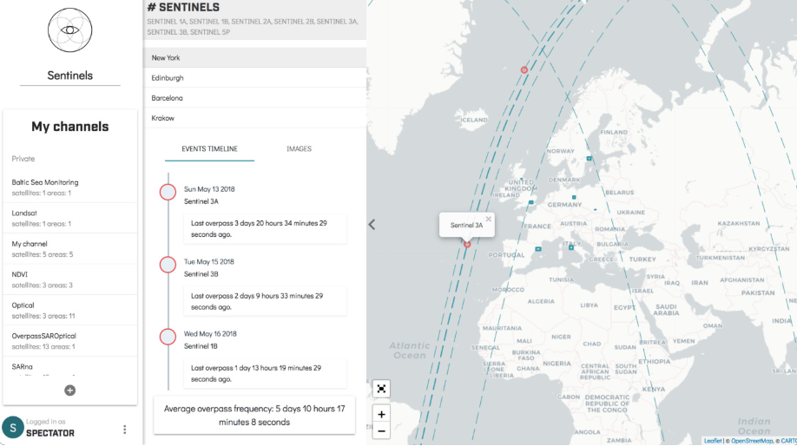
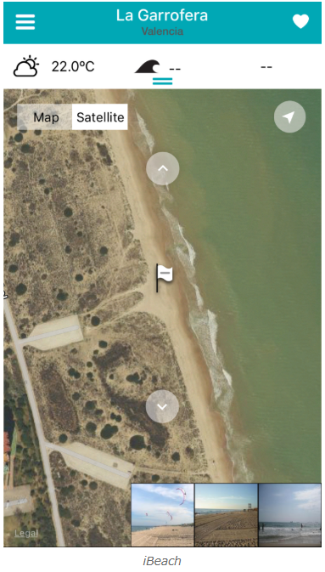
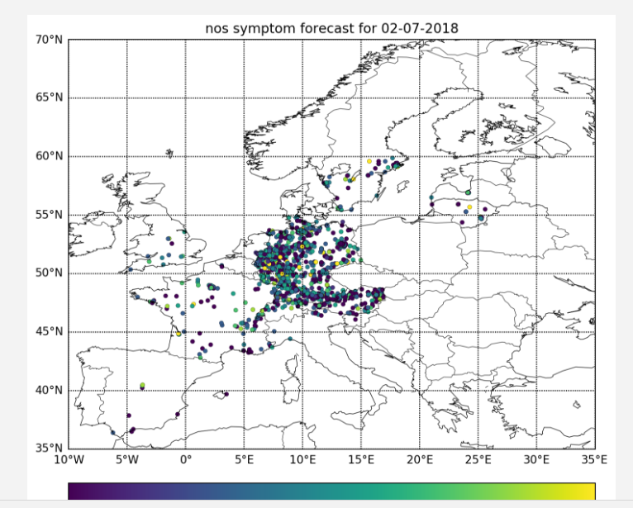
Copernicus at your fingertips
SnapPlanet
SpectatorEarth
Pasyfo
AirtextUK
iBeach
…

Slide 32
Agriculture application case study
Case study
Agriculture
Improving irrigation management in Austria with Copernicus
Irrigation cost for one year: 8 M€ to 20 M€
Improvements through optimisation of the amount of water requirements + optimisation of the distribution of individual irrigation events.
Products delivered:
crop development maps
evapotranspiration maps
weather data and forecast
Extract of the webGIS information used to deliver the information to farmers (Source: Institute of Surveying, Remote Sensing and Land Information)
23% reduction of the total service cost enabled by Sentinel data (compared to commercial satellites)
Sources: PwC-Strategy& analysis & European Commission

Slide 33




COPERNICUS DATA ACCESS: KEY LINKS
Access to Satellite data
Copernicus Online Data Access (CODA)
EUMETCast: www.eumetcast.com
FULL, FREE AND OPEN
FULL, FREE AND OPEN
Copernicus Space Component Data Access Portal*
CSC-DA
https://scihub.copernicus.eu/
https://spacedata.copernicus.eu/
Needs to get a station and pay a yearly fee
Access to Copernicus Services Data
FULL, FREE AND OPEN
Land-related data: http://land.copernicus.eu
Atmosphere-related data: http://atmosphere.copernicus.eu
Marine-related data: http://marine.copernicus.eu
Emergency-related data: http://emergency.copernicus.eu
Climate change-related data: http://climate.copernicus.eu (Beta version)
(*) Includes instructions on how to access Contributing Missions data

Slide 34
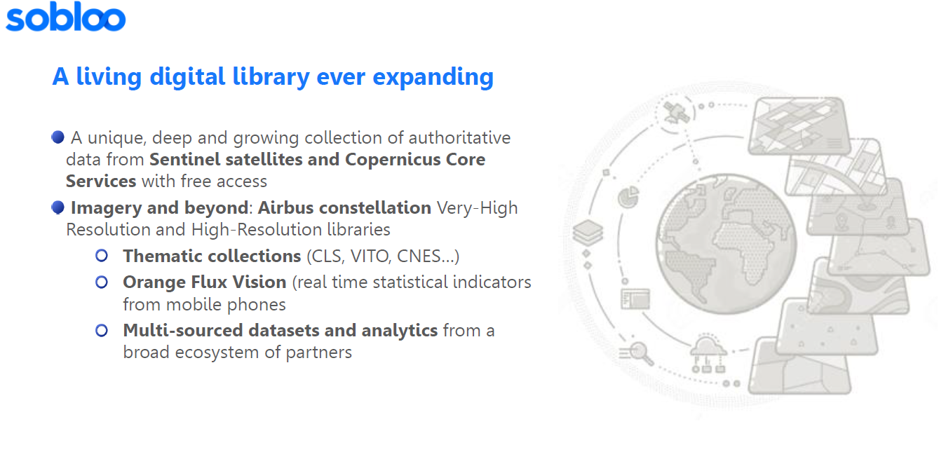
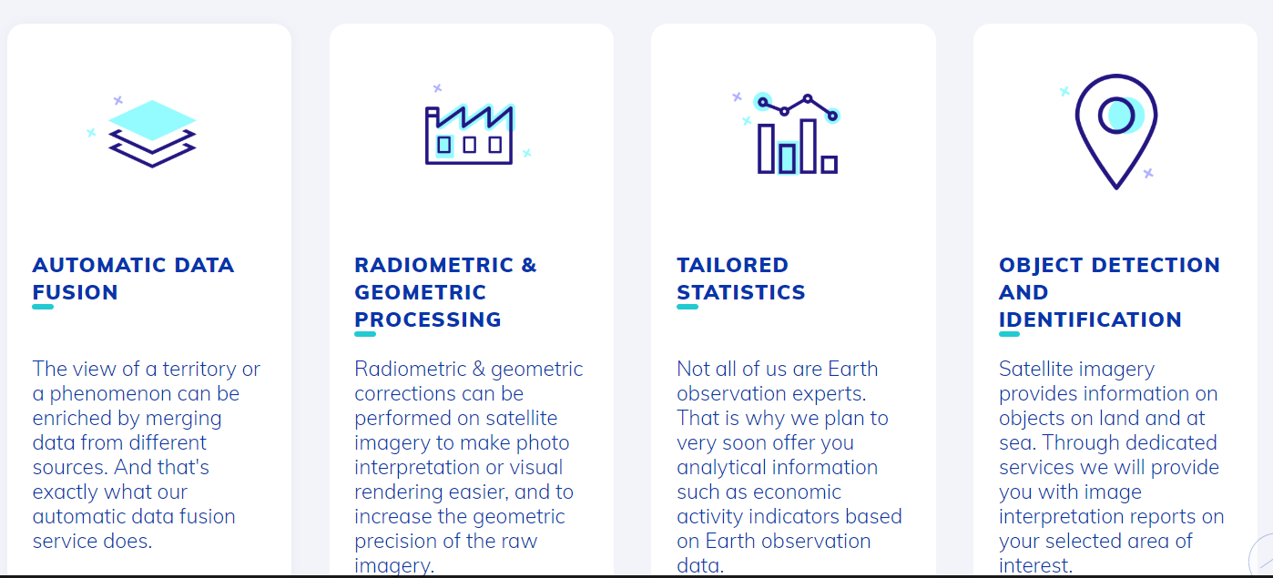
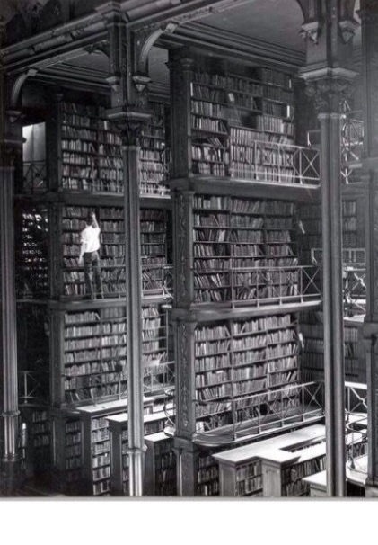
COPERNICUS BIG DATA APPROACH
Dual approach:
Strong Copernicus Distribution Services for download
Launch of several Data Access and Information Services (DIAS)
Access to all Copernicus data and information collocated with computing resources
Big Data analytics without the need to download the data and information
Data fusion with non-EO data and information
E.g. www.wekeo.eu/ - DIAS for environmental data, + virtual environments for data processing, + support
Overall ensuring that Copernicus data is easily accessible and used!
Notes:
Sobloo.eu – you can propose your services

